Slide 1

The CEO’s guide to generative AI: Business process automation for operations
Efficiency gains are just the beginning
Follow this link to download the latest version of this presentation

Slide 2


Inspire a new generation of workflow gurus By enhancing human ingenuity with generative AI, leaders can free people to focus on the high-value tasks that require empathy and creativity, not just time and energy.

Slide 3
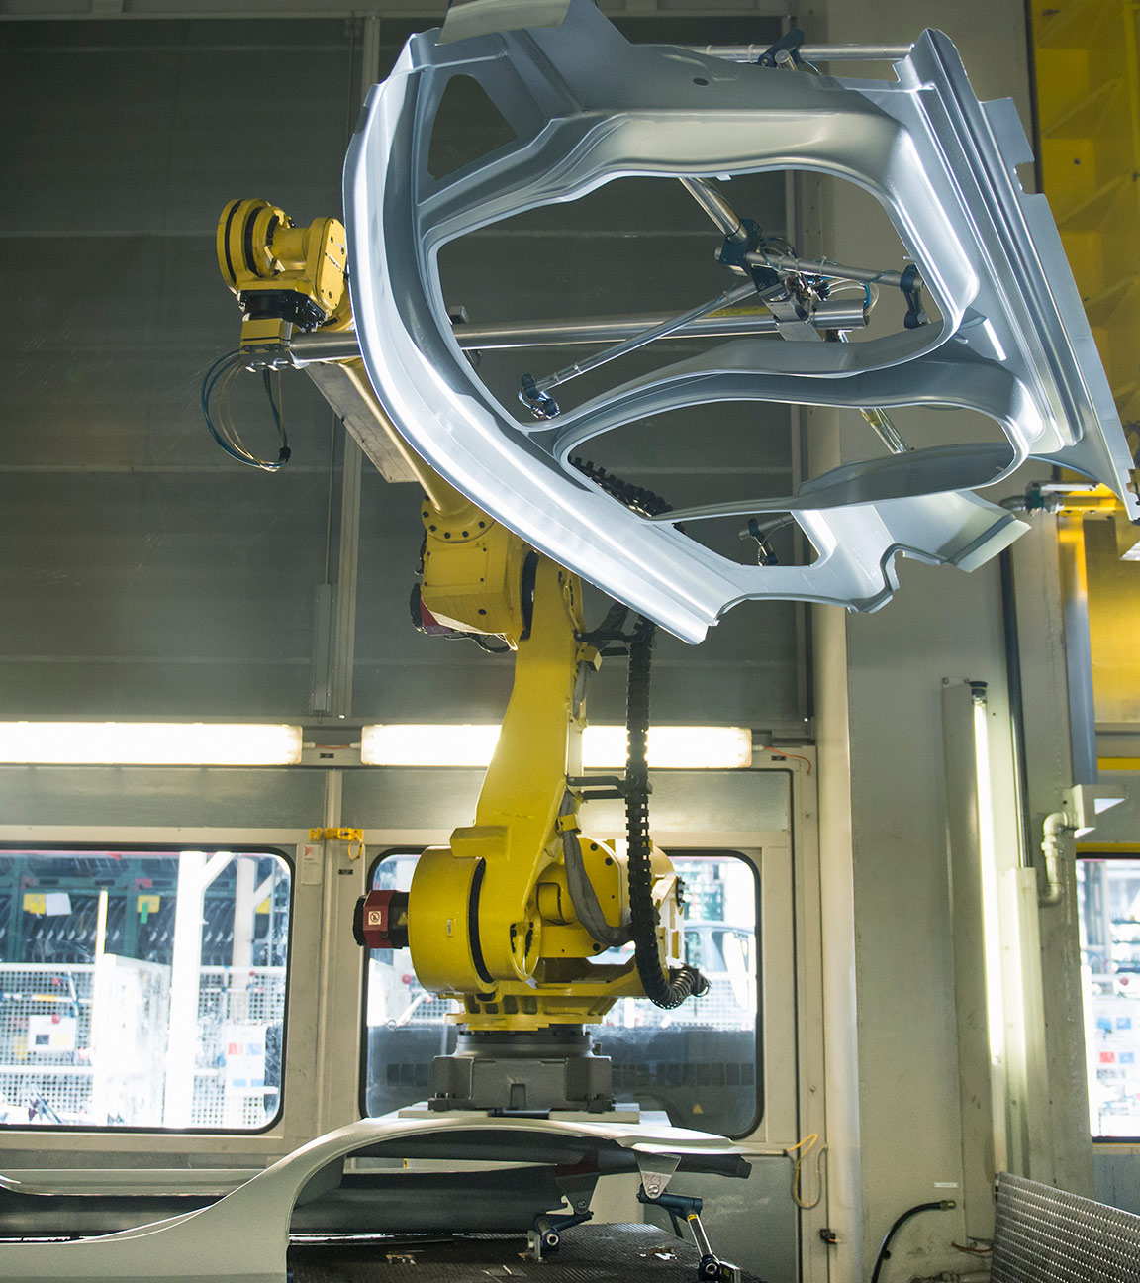
Business process automation for operations Efficiency gains are just the beginning
 | 1 | 2 | 3
What CEOs need to know | The back office will soon be a generative AI hub. | Generative AI converts technology into teammates. | Upskill and outsource to move forward faster.
What CEOs need to do | Give operations teams runway to experiment – but ask for proof points when they land. | Treat AI assistants like racecars and employees like professional drivers. | Trade control for capability

Slide 4
Three things
Experimentation
Augmented work
Skills and capabilities

Slide 5
What CEOs need to know The back office will soon be a generative AI hub
Experimentation
Executives are optimistic about what generative AI can do…
But..
augmentation of processes with generative AI planned by 2025, with growth distributed almost equally across HR and the finance processes of source to pay, lead to cash, and record to analyze
in productivity expected by executives by applying generative AI to business processes
4/10
61%
41%
data privacy concerns and employee resistance to adoption are significant hurdles to application of generative AI to business processes
&
executives say…
more
increase
Notes:
Source:
2023 IBV BPO survey data (Global datapoint n=400) Q7 Relative %age difference of "Average of HR, S2P, O2C and R2R across functions/processes Gen AI 2025" over "Average of HR, S2P, O2C and R2R across functions/processes Gen AI 2023”.
2023 IBV BPO survey data (Global datapoint n=100) Q8R2R_3.1.
2023 IBV BPO survey data (Global datapoint n=400) Q4 "4.1 Cultural resistance to adoption " and "4.9 Concerns about privacy of data and information" combined.

Slide 6
What CEOs need to do
Experimentation
Give operations teams runway to experiment—but ask for proof points when they land
Share learnings in real time to accelerate speed-to-value. Ask employees to relay their experiences in collaborative communication channels and documentation portals.
Reward your team’s innovative spirit—not just big wins—to discover new ways to boost ROI. Incentivize big-picture process innovation, small-scale efficiency gains, and fast failure that leads to valuable lessons learned.
Increase productivity through predictive analytics. Use generative AI to detect patterns and trends that highlight opportunities to streamline workflows. Adopt flexible operating models to respond quickly to the insights it uncovers.

Slide 7
Three things
Experimentation
Augmented work
Skills and capabilities

Slide 8
What CEOs need to know Generative AI converts technology into teammates
Augmented work
Executives feel generative AI tools can be effective teammates
of executives expect generative AI-powered assistants will be able to query, validate, and aggregate information reliably for employees
of executives say their employees will need to work in tandem with digital teammates to deliver seamless processes by 2025
of executives say succeeding with AI will depend more on people’s adoption than the technology itself
say they’re pushing their organization to adopt generative AI faster than some people are comfortable with
Human element is the biggest concern for top leaders
of executives say AI assistants will execute most traditional processes by 2025
of executives feel employees will interact with AI assistants as their primary point of intelligence for transactional tasks by 2025
of executives say CFO self-service assistants will be crucial for automating record to analyze processes
of executives say employee self-service assistants in HR will be crucial
But the potential upside for employees that embrace generative AI is substantial
And some areas are farther along in the transformation than others
87%
64%
60%
63%
64%
61%
64%
61%
Notes:
Source:
2023 IBV The Power of AI and Automation survey data (Global datapoint n=2,000) Q22.1 "3", "4", "5 To a great extent" combined.
2024 IBV CEO Pulse survey data (Global datapoint n=564) EP18.2 "3 Agree" and "4 Strongly agree" combined.
2023 IBV BPO survey data (Global datapoint n=400) Q1_2.4 "3 Agree" and "4 Strongly agree" combined.
2023 IBV BPO survey data (Global datapoint n=100) Q5R2R_2.7 "3 Moderate importance" and "4 High importance" combined.
2023 IBV BPO survey data (Global datapoint n=400) Q3_2.7 "3 Agree" and "4 Strongly agree" combined.
2024 IBV CEO Study survey data (Global datapoint n=2500) E22.3 "3 Agree" and "4 Strongly agree" combined.
2023 IBV BPO survey data (Global datapoint n=400) Q1_2.1 "3 Agree" and "4 Strongly agree" combined.
2023 IBV BPO survey data (Global datapoint n=100) Q5HR_2.8 "3 Moderate importance" and "4 High importance" combined.

Slide 9
What CEOs need to do
Augmented work
Treat AI assistants like racecars–and employees like professional drivers
Reduce drag with streamlined design. Identify the processes that create the greatest frustration for operations teams and find ways to automate them.
Reinforce guardrails. Train people to use generative AI responsibly so that they aren’t afraid to push the pedal to the metal.
Teach generative AI to take the wheel when needed. Implement a self-learning training program for generative AI to improve its performance and accuracy in tasks such as compliance risk assessment, fraud detection, and profitability analysis.

Slide 10
Three things
Experimentation
Augmented work
Skills and capabilities

Slide 11
What CEOs need to know Upskill and outsource to move forward faster
Skills and capabilities
Executives are investing in new skills and roles for generative AI
Investments in generative AI-specific skills will increase significantly
Executives are also looking to turbocharge their efforts with external expertise
Processes most likely to be outsourced in each of the following areas to accelerate digital transformation with AI:
HR – training (61%)
S2P – sourcing (59%)
O2C – sales support services (67%)
R2A – general accounting transactions and processing (61%)
↓ +18%
Processes where executives are investing
84%
HR
76%
Record to analyze
73%
of skill budgets are expected to be allocated to generative AI-specific skills in 2025 compared to 2023.
Lead to cash
71%
CEOs will need to strike the right balance between building internal capabilities that strengthen their competitive advantage and partnering to gain the skills and expertise that will support their growth.
Source to pay
Notes:
Source:
2023 IBV BPO survey data (Global datapoint n=100) Q9R2R_3.1 "3 Likely" and "4 Extremely likely" combined.
2023 IBV BPO survey data (Global datapoint n=100) Q9R2R_3.4 "3 Likely" and "4 Extremely likely" combined.
2023 IBV BPO survey data (Global datapoint n=100) Q9R2R_3.3 "3 Likely" and "4 Extremely likely" combined.
2023 IBV BPO survey data (Global datapoint n=100) Q9R2R_3.2 "3 Likely" and "4 Extremely likely" combined.
2023 IBV Gen AI impact on Labor survey data (Global datapoint n=300) D7E.3 Relative %age difference of "D7E.3 2025" over "D7E.2 2023".
2023 IBV BPO survey data (Global datapoint n=100) Q6HR.4 "3 Likely" and "4 Extremely likely" combined.
2023 IBV BPO survey data (Global datapoint n=100) Q6S2P.1 "3 Likely" and "4 Extremely likely" combined.
2023 IBV BPO survey data (Global datapoint n=100) Q6O2C.2 "3 Likely" and "4 Extremely likely" combined.
2023 IBV BPO survey data (Global datapoint n=100) Q6R2R.1 "3 Likely" and "4 Extremely likely" combined.

Slide 12
What CEOs need to do
Skills and capabilities
Trade control for capability
Outsource to scale expertise. Partner with BPO providers to augment internal capabilities, expand possibilities for automation and workflow optimization, and quickly deploy the most advanced AI and automation technologies at pace.
Create career paths that don’t exist today. Explore what new roles your organization should add. Employ process orchestrators to manage AI assistants across end-to-end processes. Tap digital librarians to manage prompt libraries, generative AI models, and governance and ethical guidelines.
Optimize processes with experience designers. Define a compelling value proposition for process automation and design experiences that deliver the intended benefits and exceed user expectations.

Slide 13

Links to additional content
IBV Main Page | ibm.com/ibv
The CEOs Guide to generative AI | https://www.ibm.com/thought-leadership/institute-business-value/en-us/report/ceo-generative-ai
Generative AI: The state of the market | https://www.ibm.com/thought-leadership/institute-business-value/en-us/report/generative-ai-enterprise-priorities
From cost center to value creator | https://www.ibm.com/thought-leadership/institute-business-value/en-us/report/ceo-generative-ai/customer-service
A new frontier for the future of work | https://www.ibm.com/thought-leadership/institute-business-value/en-us/report/ceo-generative-ai/talent-skills

